Slide 1


An Efficient Job Portal Website
Presented By
1. MD. ATIKUR RAHMAN
(193311049)
2. MOST. SHAKILA KHATUN
(202311008)
3. MD. MONIRUZZAMAN PAVEL
(193311068)
Supervised by
A.S.M Delwar Hossain
Lecturer
Department of CSE
Varendra university

Slide 2
Discussion topic
Introduction
Motivation
Background Study
Implemented Features
Tools and Technology
Activity Diagram of Website
Entity Relationship Diagram of website
Website Deployment
Our Website’s Improvement Result
Graphical view of the System
Time Frame
Conclusion
Future Work
References

Slide 3
Introduction
Our job portal website will focus on job searching and recruitment.
It will help individuals to find employment opportunities and companies to identify suitable candidates.

Slide 4
Motivation
The existing system is bdjobs.com. But there are 2 problems with the website. There are:
Its loading time is 21.6 seconds, more than the standard.
Sometimes the website shows irrelevant search results.
For these two reason, we have decided to build this project.

Slide 5
Background Study
Websites visited before starting the project:
Bdjobs [1]
PHP documentation [2]
W3school [3]
Analysis done before starting the project :
Market Analysis
Feature Analysis
Technical Analysis

Slide 6
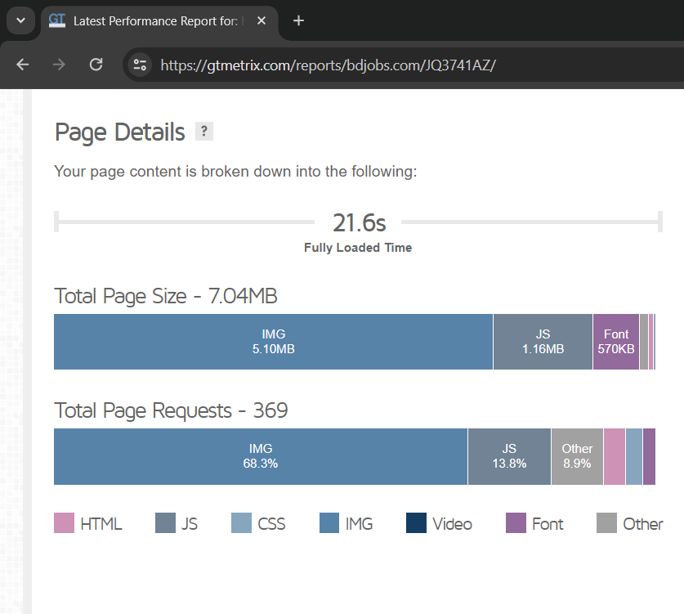
Problem 1: Website loading time is 21.6s!

Slide 7
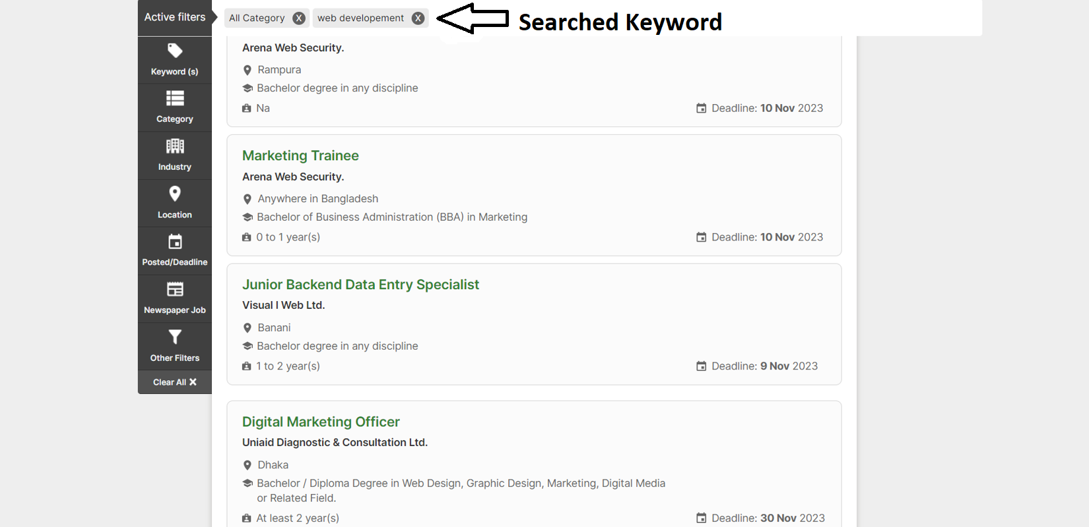
Problem 2: It’s showing irrelevant search results.

Slide 8
Implemented Features
Job Searching
Job Listings
Sign Up
Log In
Employer Dashboard
Edit Company profile
View Company Profile
Post a job
Manage job postings (Edit, Delete, View applicants)
Apply To Job
View Applied Jobs
Logout
Password reset

Slide 9
Tools and Technology
Tools | Purpose
HTML, CSS, Bootstrap, JavaScript, DataTables library | To modify the website’s front-end
PHP, SQL | To implement back-end logic and manipulate data within RDBMS
Azure Communication Service, Node.js | To send the password reset email and build an email-sending API
DigitalOcean, CloudPanel, Docker | To deploy the website on a server and Containerize the email-sending API
Visual Studio Code, XAMPP, GitHub | For local development environment and version controlling

Slide 10
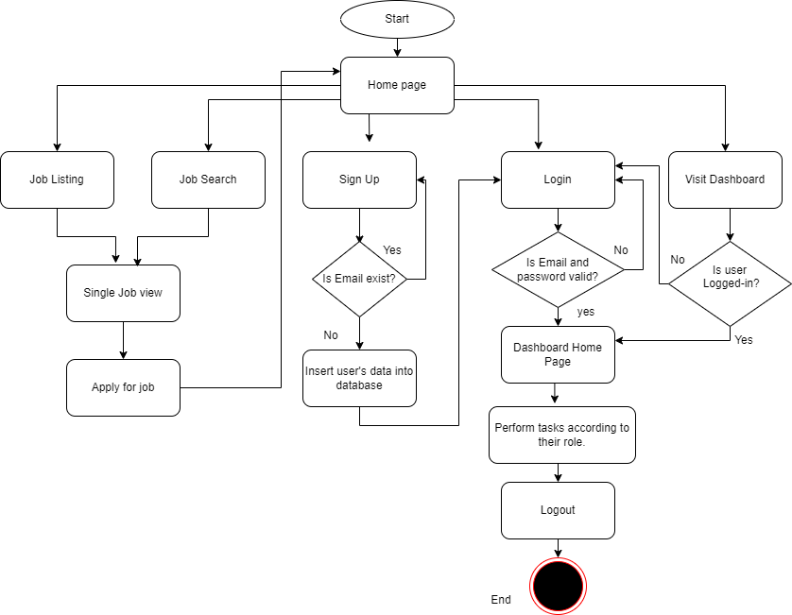
Activity Diagram of Website

Slide 11
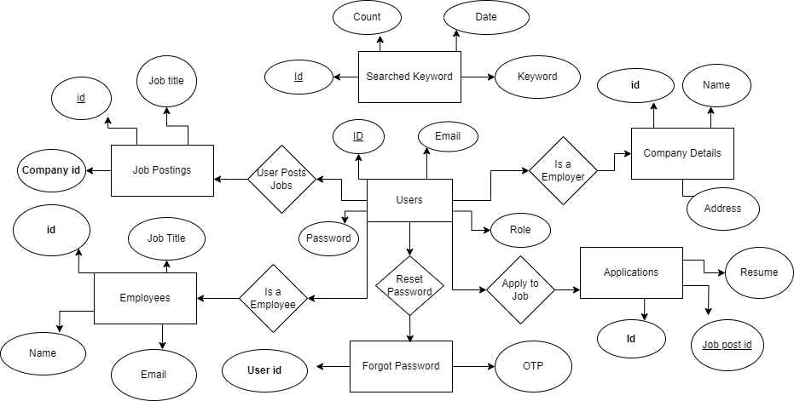
ER Diagram of website

Slide 12
Website Deployment
Our website is hosted on the following URL. So anyone can visit our website.
https://jobboard.atikapps.com/

Slide 13
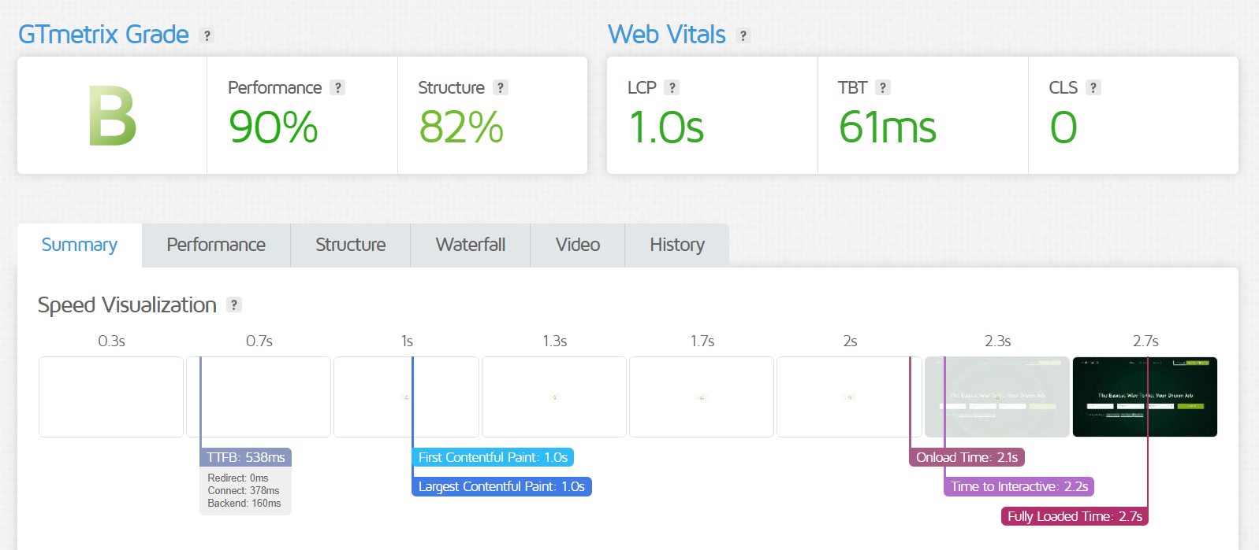
Our website’s improvement result

Slide 14
GRAPHICAL VIEW OF THE SYSTEM

Slide 15
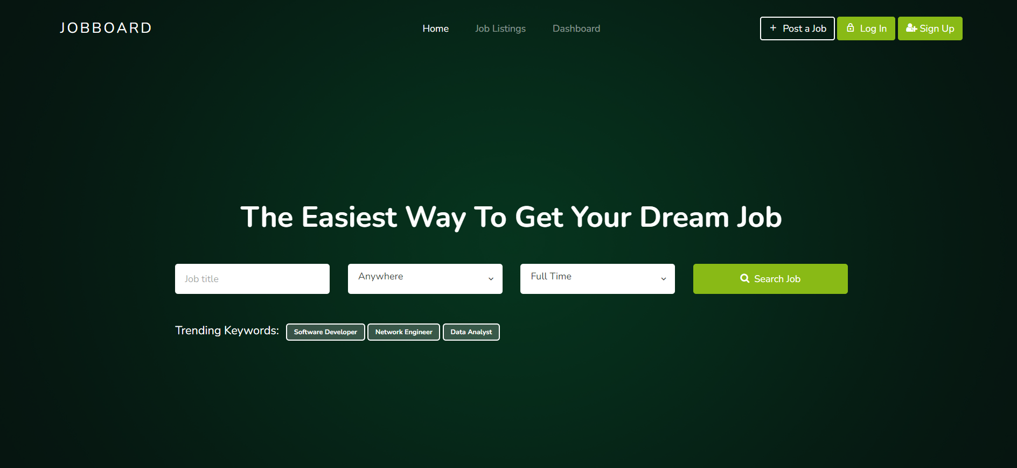
Our Website’s Home Page

Slide 16
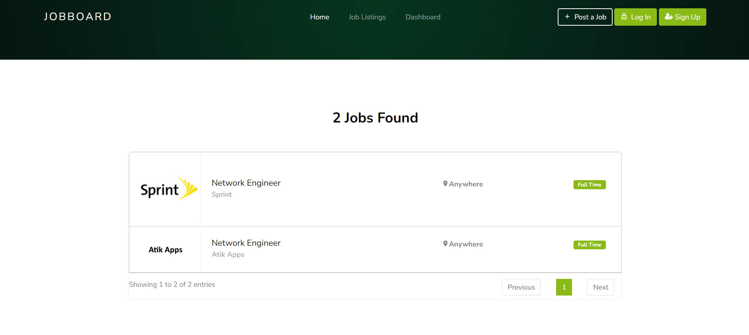
Job search result

Slide 17
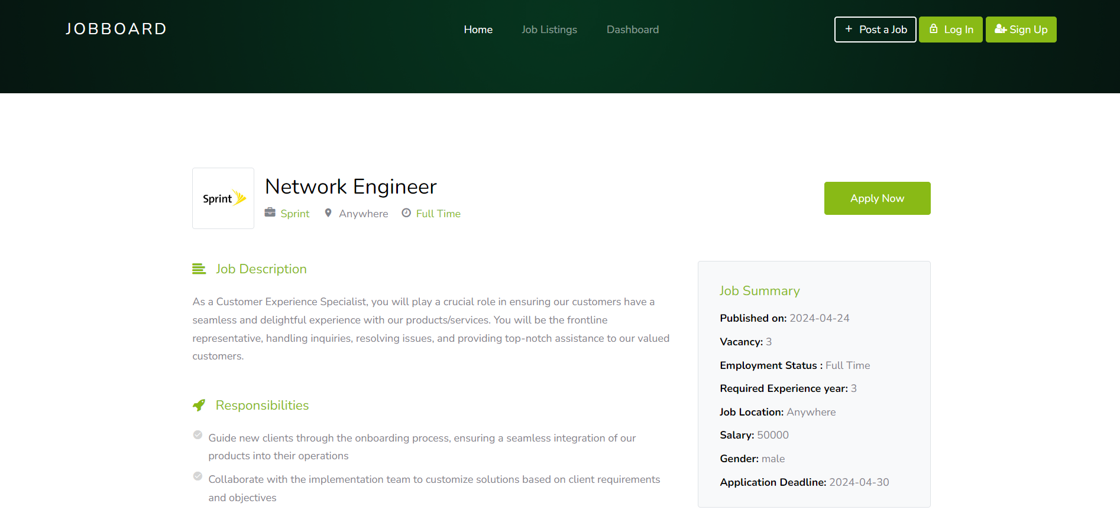
Single job view

Slide 18
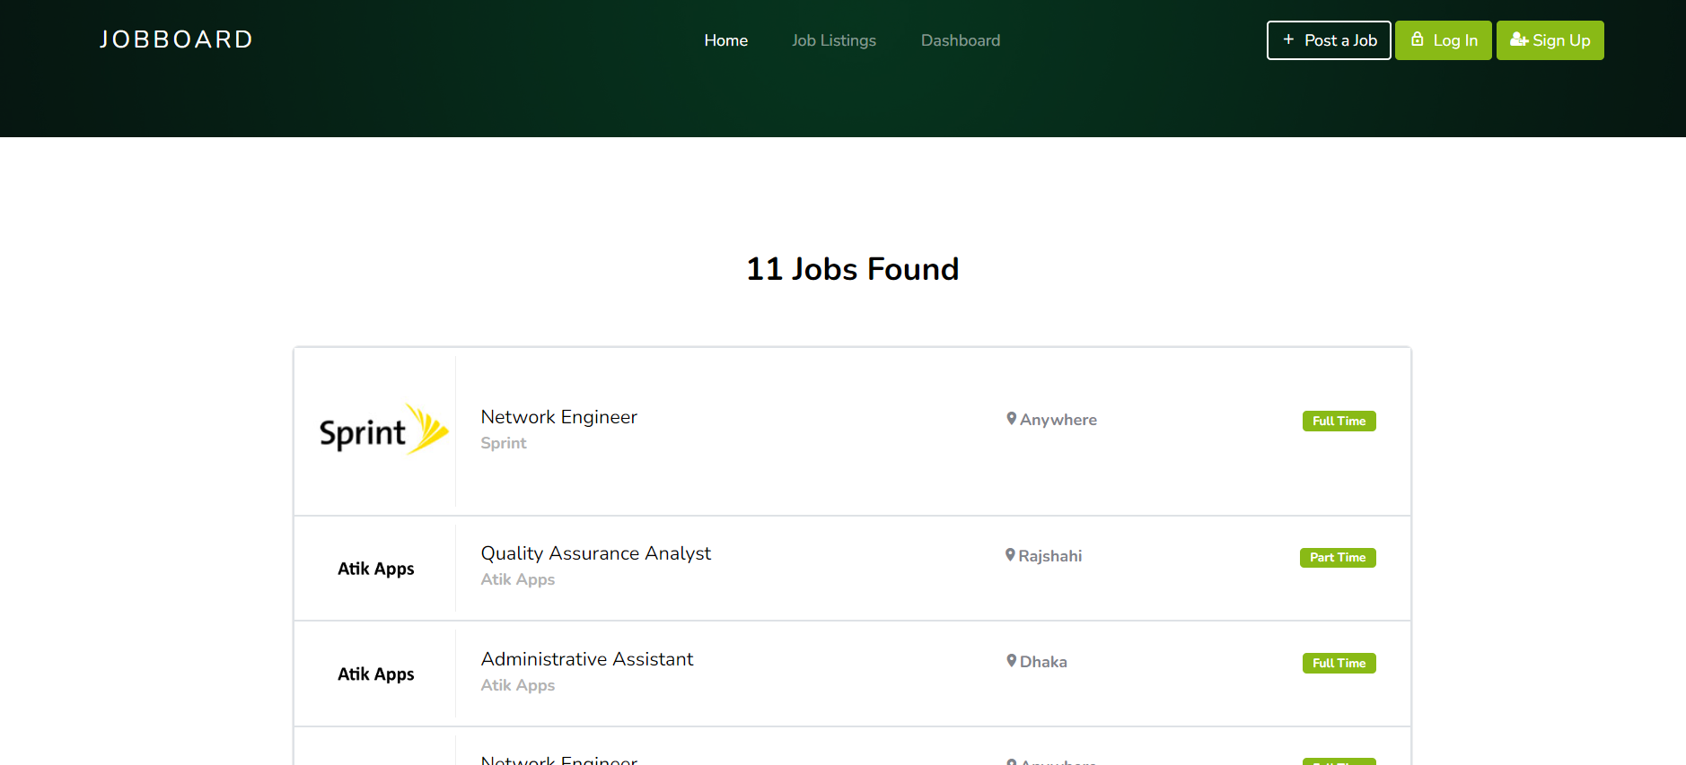
Job Listing

Slide 19
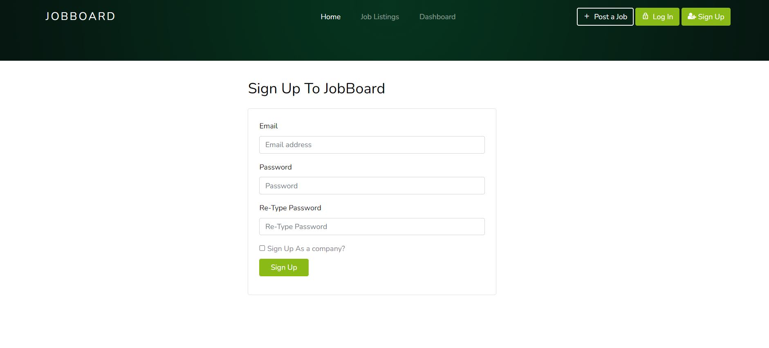
Sign Up

Slide 20
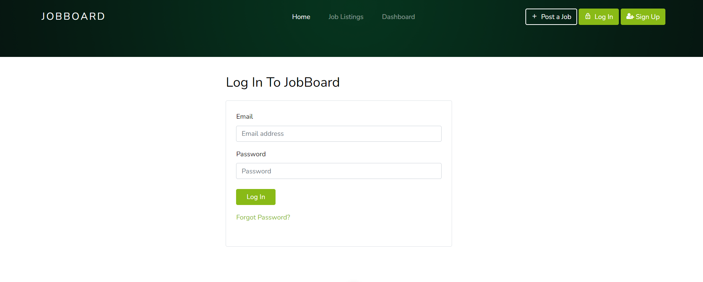
Log In

Slide 21
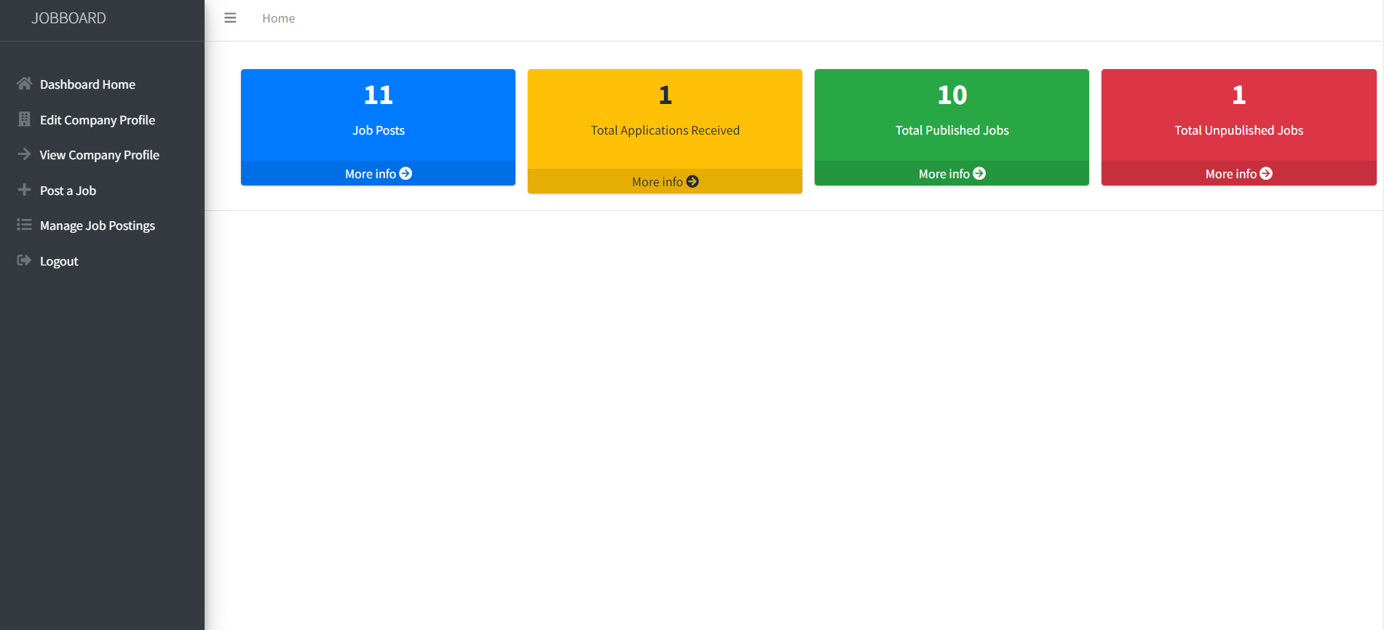
Employer Dashboard

Slide 22
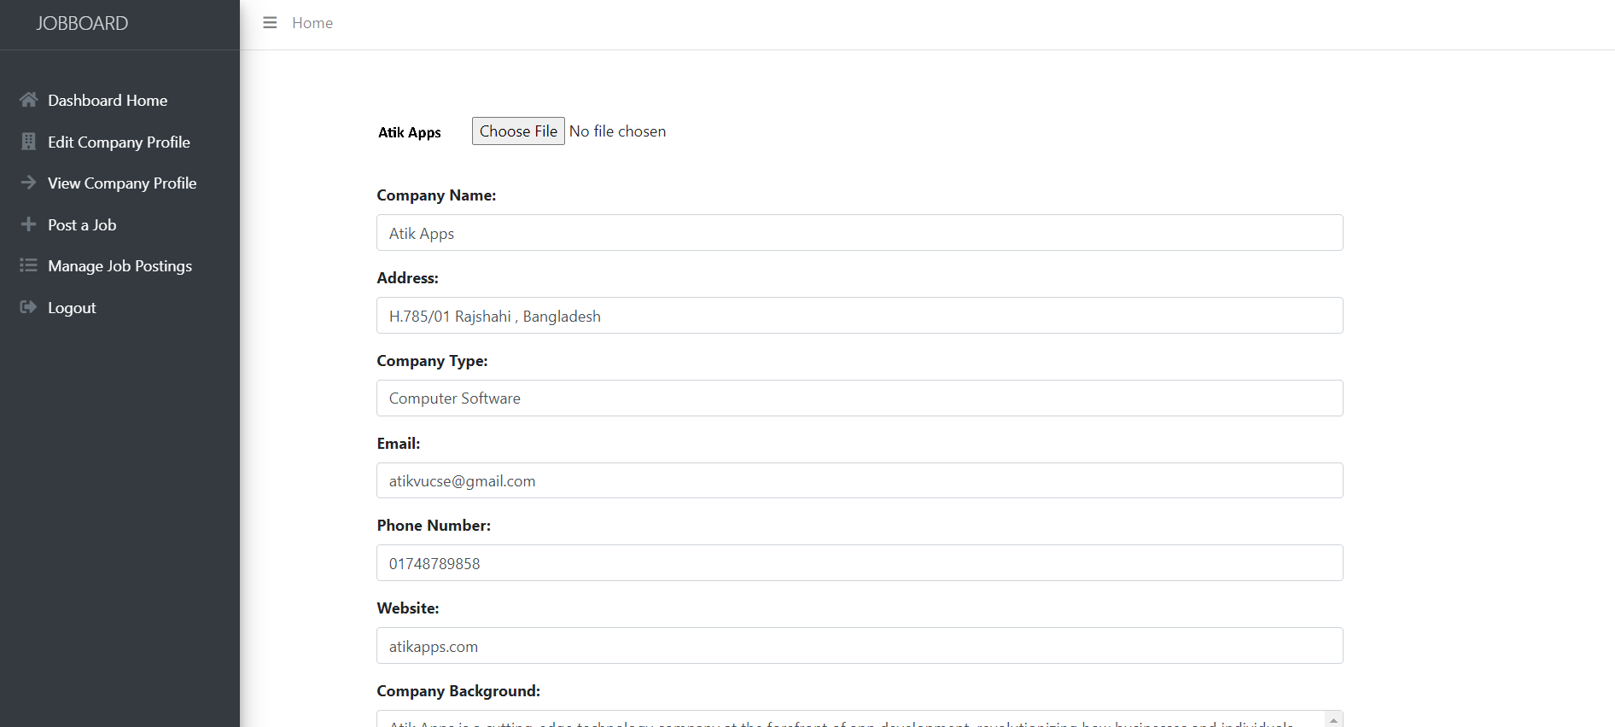
Edit Company Profile

Slide 23
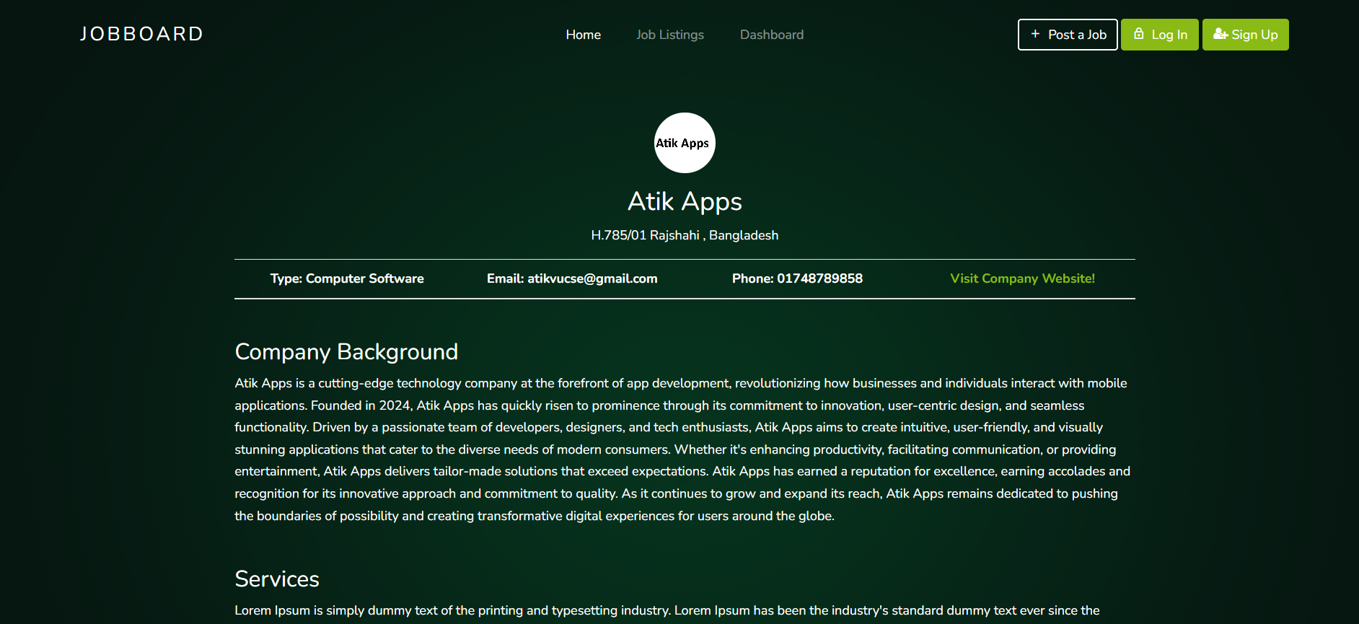
View Company Profile

Slide 24
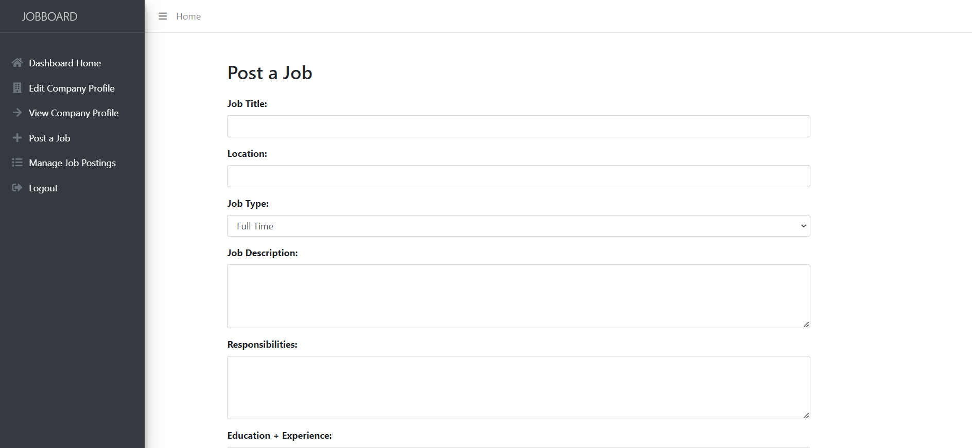
Post a job

Slide 25
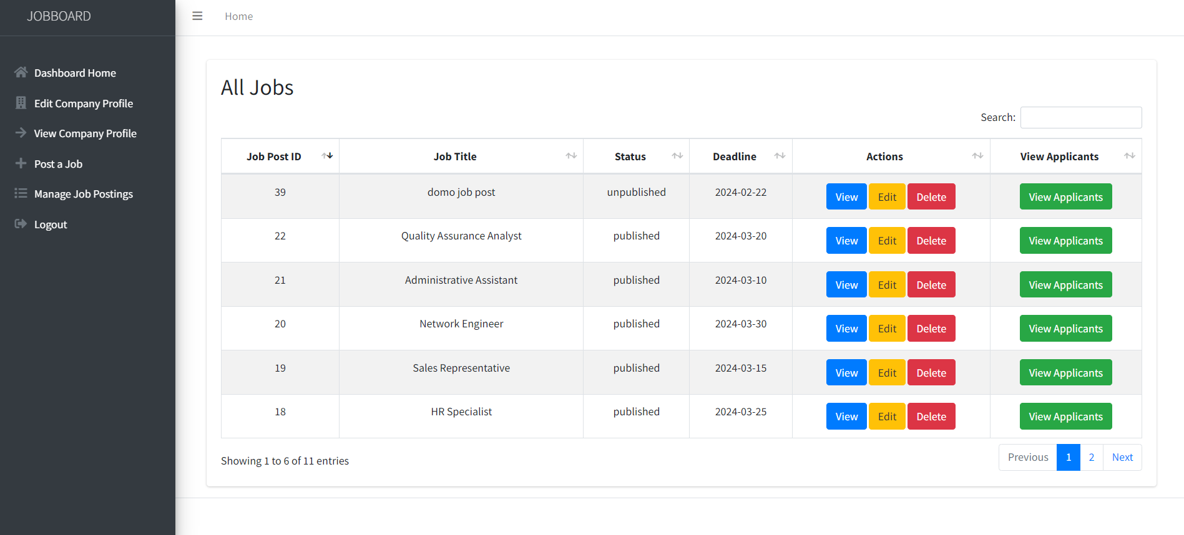
Manage job postings

Slide 26
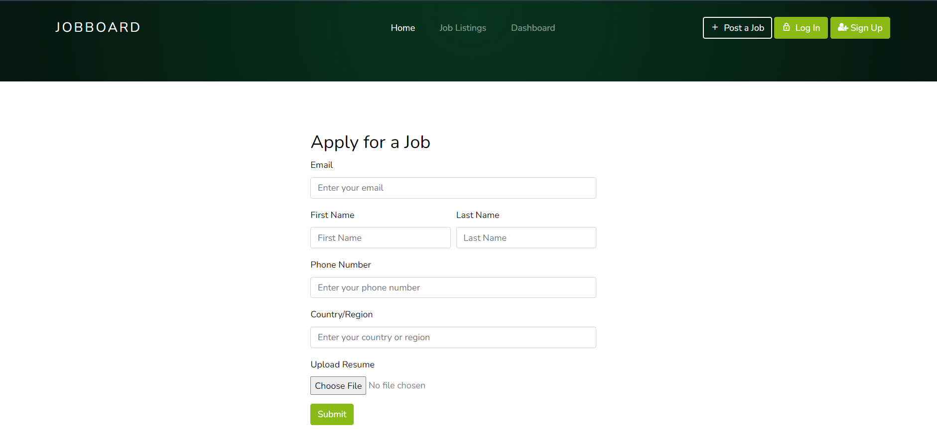
Apply for a job

Slide 27
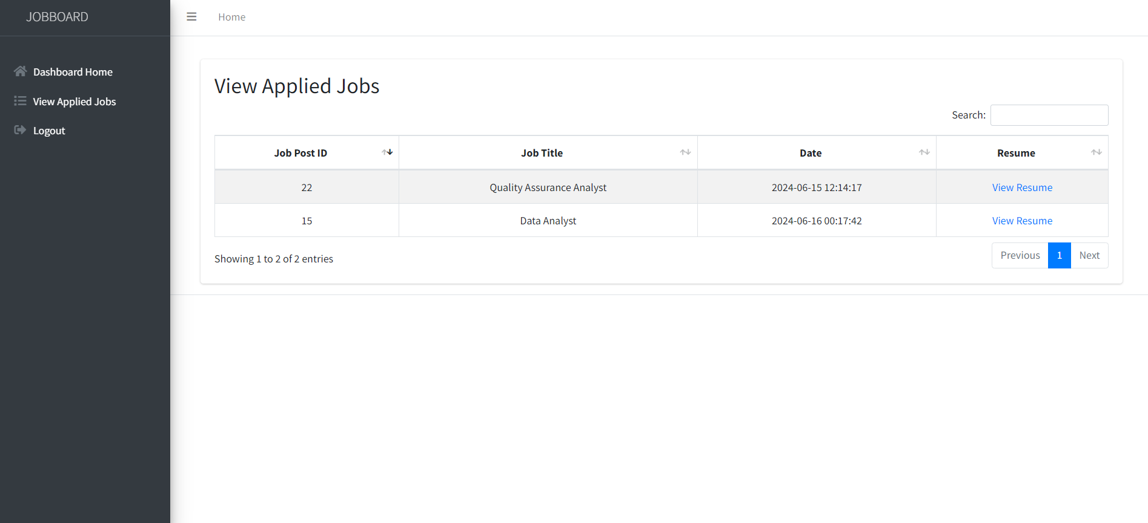
View Applied Jobs

Slide 28
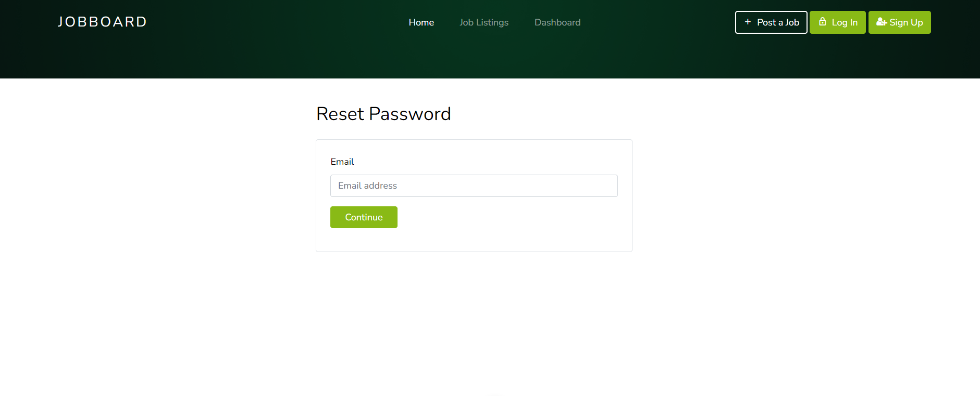
Password reset

Slide 29
Time Frame
From July 2023 to September 2023: Identified existing system weaknesses.
From October 2023 to December 2023: Market Research, Feature Analysis, Technical Analysis.
In January 2024: Sign Up, Login, Logout, and Password reset.
In February 2024: Employer Dashboard, Edit Company profile, View Company Profile.
In March 2024: Post a job and manage job postings.
In April 2024: Job Searching, Job Listings.
In May 2024: Apply for a job.
In June 2024: View Applied Jobs.

Slide 30
Conclusion
Our website’s user-friendly interface simplifies the job search process.
It serves as a crucial link between job seekers and employers.

Slide 31
Future Work
We will implement the following features in the future:
Job recommendation system based on skill.
Advanced job filtering options.
Push Notification system.
Mobile application for the website.
UI/UX upgrades.

Slide 32
References
[1]. https://bdjobs.com/
[2]. https://www.php.net/docs.php
[3]. https://www.w3schools.com/

Slide 33
Thank You

